Slide 1

AWS Database Services
Relational Database Service (RDS) Agenda
- RDBMS supported
- RDS Backups
- RDS Encryption
- RDS Multi-AZ
- RDS Read Replica
- Aurora & Serverless Aurora
- Demo
28th April 2020
Ashok Raj Venkatachalapathy

Slide 2
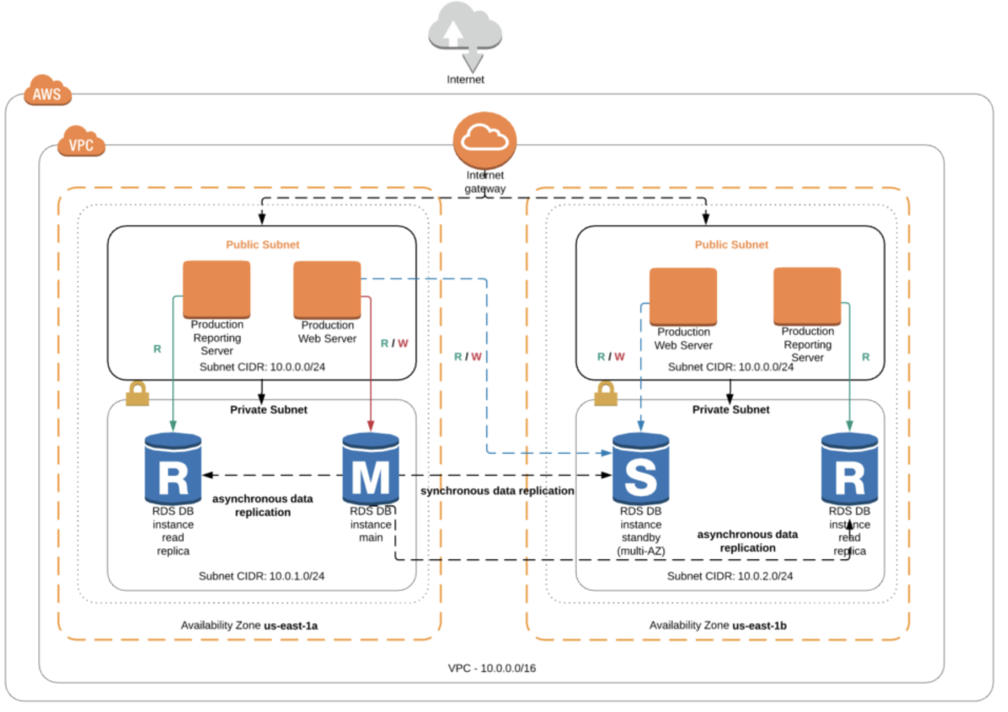
Enterprise web application - Architecture
Notes:
https://dbseer.com/aws_rds-architecture-blueprint/

Slide 3
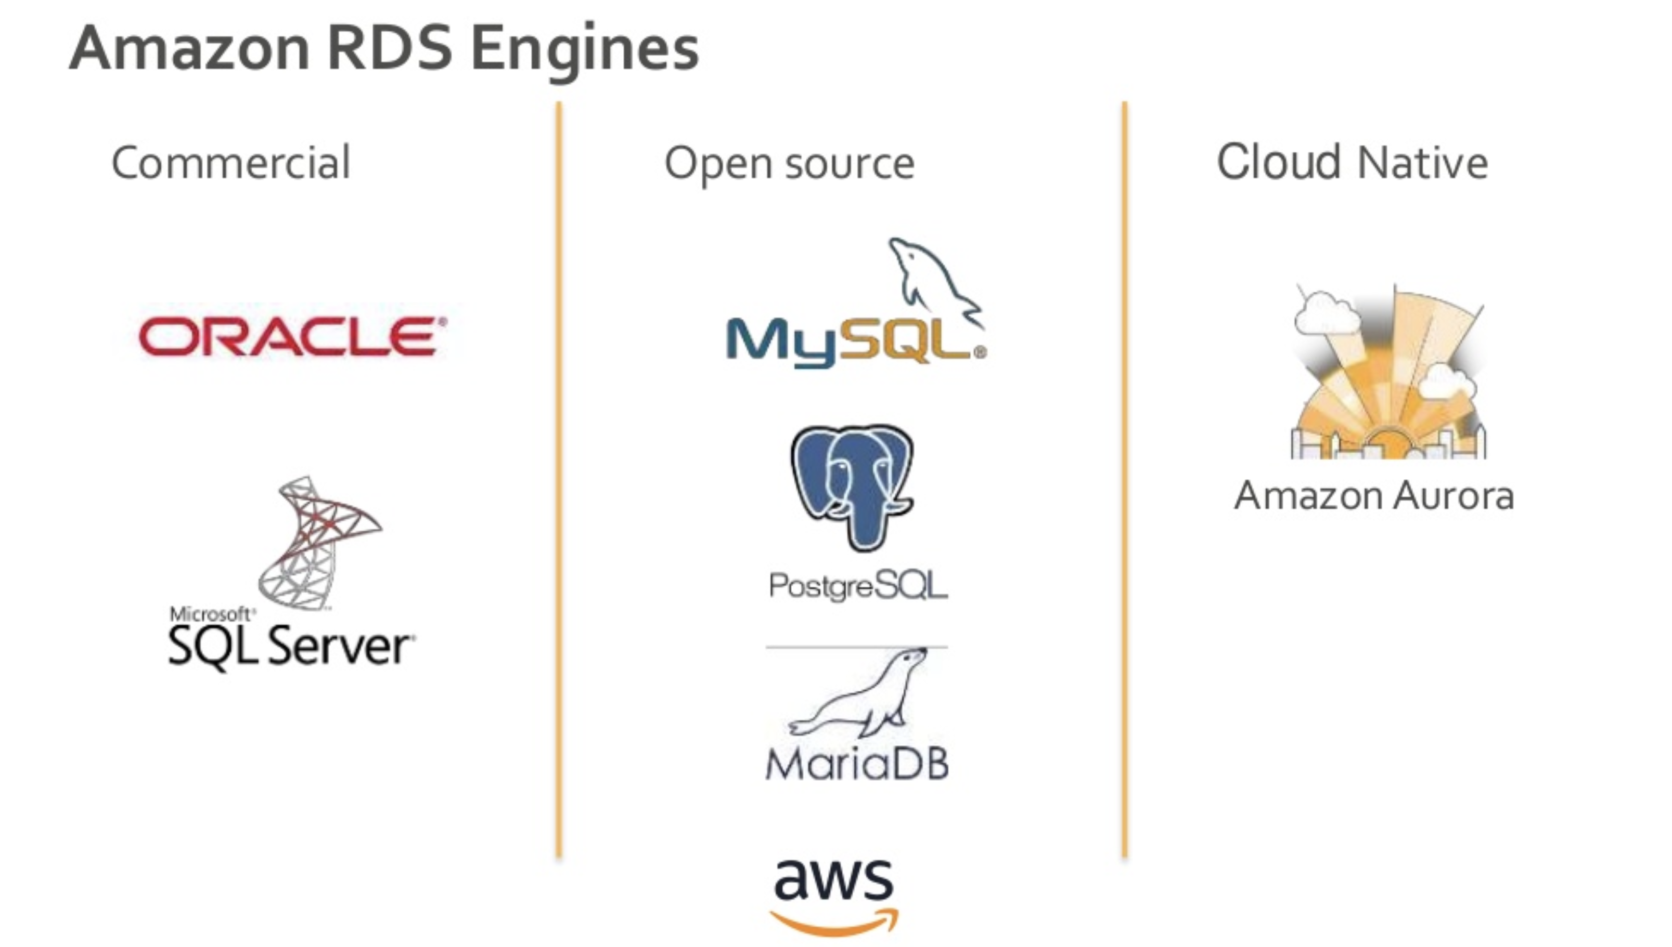
Amazon RDS Engines
Notes:
https://aws.amazon.com/products/databases/
MySQL is a fast, easy-to-use RDBMS being used for many small and big businesses. MySQL is developed, marketed and supported by MySQL AB, which is a Swedish company
MariaDB: (2009)
MariaDB is a fork of the MySQL relational database management system. The original developers of MySQL created MariaDB after concerns raised by Oracle's acquisition of MySQL
PostgresQL history:
Ingress (1980) – Postgres (1986) – Postgres95 (1995) – PostgreSQL
Open source relational database management system (DBMS) developed by a worldwide team of volunteers. PostgreSQL is not controlled by any corporation or other private entity and the source code is available free of charge

Slide 4


RDS Features
Backups: Automated & Manual
Automatic backup of RDS instance
Full daily snapshot + transaction logs throughout day
Backup in S3
Retention period; 1 to 35 days
Point-in-time restore → creating a new DB instance
also Check LatestRestorableTime
Manual Database snapshots: user initiated; not auto deleted
Stays even original DB instance is deleted
Restore → New RDS instance; new endpoint
Both auto & manual snapshots: Within region, across region & across account
Best practice for performance: Schedule when application usage is low, backtrack
AWS Backup
Snapshot
Notes:
https://aws.amazon.com/rds/details/backup/
https://docs.aws.amazon.com/AmazonRDS/latest/UserGuide/USER_WorkingWithAutomatedBackups.html
https://docs.aws.amazon.com/AmazonRDS/latest/AuroraUserGuide/Aurora.Overview.html

Slide 5

RDS Features
Encryption
Supported for MySQL, Oracle, SQL Server, PostgreSQL, MariaDB & Aurora
Encryption using KMS service
Once applied, data stored @ rest is encrypted and applies to backups, read replicas and snapshot
Encrypted data

Slide 6
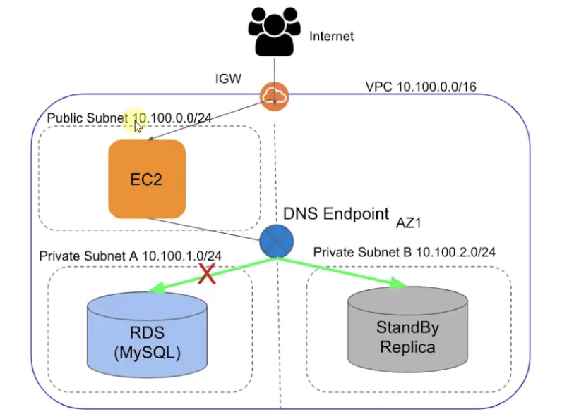
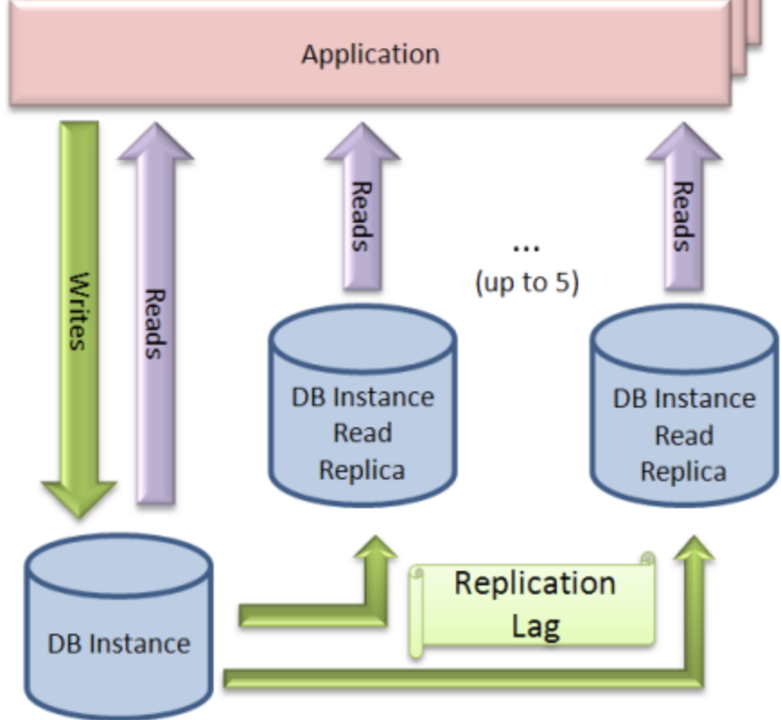
RDS Features
Multi AZ
For SQLServer, Oracle, MySQL Server, PostgreSQL, MariaDB
(Note Aurora is completely Fault tolerant)
High availability
Synchronous replication
Same endpoint
Automatic failover (During planned maintenance or failure)
Read replicas
For Oracle, MySQL Server, PostgreSQL, MariaDB, Aurora
Auto backup of RDS mandatory
To scale out beyond single DB – for read heavy workloads
Asynchronous copy (upto 5 copies)
Different endpoint
Pricing
Storage, backups, snapshot export, Data transfer
Notes:
https://aws.amazon.com/blogs/database/using-in-region-read-replicas-in-amazon-rds-for-sql-server/?nc1=b_rp
https://docs.aws.amazon.com/AmazonRDS/latest/UserGuide/USER_Events.html

Slide 7
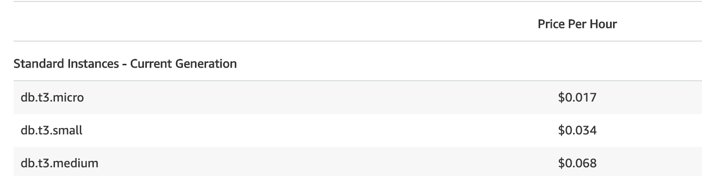
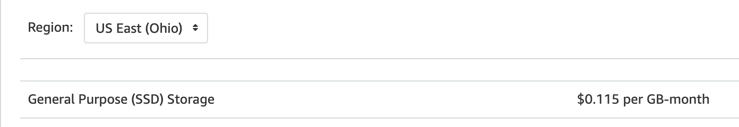
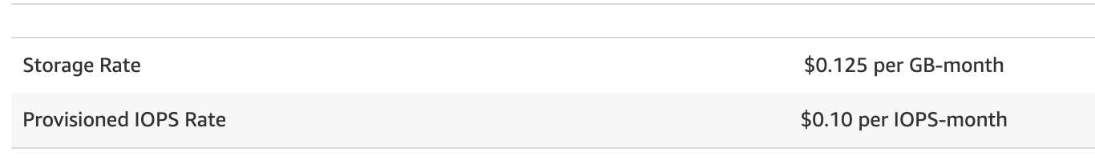
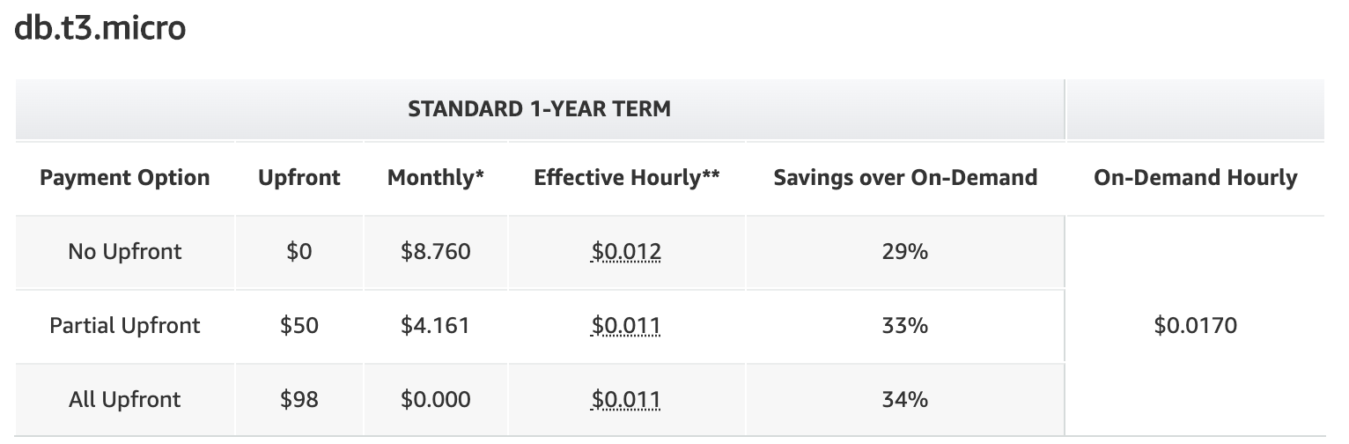
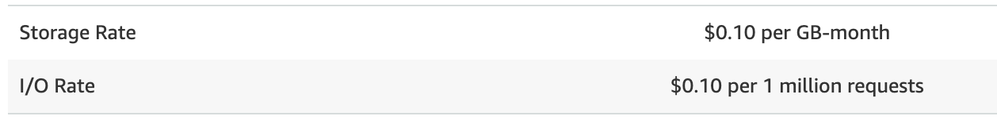
RDS Pricing
RDS pricing
By DB instance types On-demand DB instances; Reserved instances;
By storage types General purpose; Provisioned IOPS; Magnetic storage
Backup storage
Snapshot export
For Data transfer: IN & OUT
https://aws.amazon.com/rds/mysql/pricing/?pg=pr&loc=2
Notes:
Pricing:
https://aws.amazon.com/rds/aurora/pricing/
https://aws.amazon.com/blogs/database/using-in-region-read-replicas-in-amazon-rds-for-sql-server/?nc1=b_rp
https://aws.amazon.com/rds/aurora/pricing/?pg=pr&loc=1

Slide 8
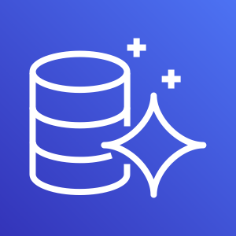
Aurora – Basics & features
What it is? and it’s features:
MySQL & PostgreSQL compatible RDBMS engine, which combines speed and availability of high-end commercial DB, with simplicity and cost effectiveness of open source DB
5X times better performance than MySQL & 3X better perf than PostgreSQL
Encryption using KMS service
Storage autoscale: Starts @ 10GB, and scaling @ +10GB increments; upto 64TB
Compute scaling: upto 32vCPUs & 244 GB of mem
Contains 6 copies of data (2 copies in each available zone; min 3 AZ)
Availability: Designed to handle:
2 copies of data (write availability) & up to 3 copies of data (read availability)
Self healing:
Storage data blocks and disks are continuously scanned for errors and repairs automatically
Backtrack enable option
Regional & Global DB
Replicas:
Aurora replicas (15); MySQL read replicas (5)
Asynchronous replication are in milliseconds
Amazon Aurora
Notes:
https://docs.aws.amazon.com/AmazonRDS/latest/AuroraUserGuide/Aurora.Overview.html
https://docs.aws.amazon.com/AmazonRDS/latest/AuroraUserGuide/aurora-global-database.html
https://docs.aws.amazon.com/AmazonRDS/latest/AuroraUserGuide/aurora-serverless.html

Slide 9
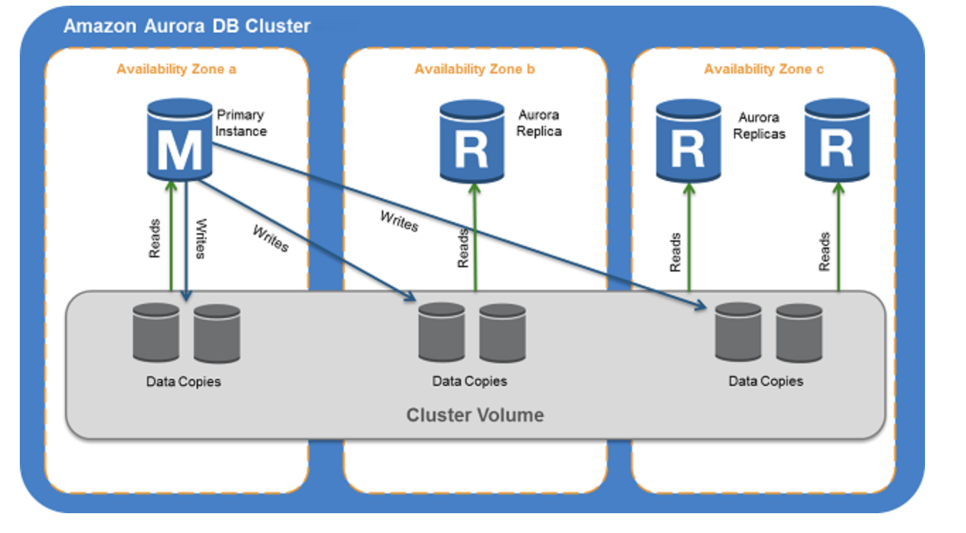
Aurora – DB cluster volumes
Amazon Aurora
Notes:
https://docs.aws.amazon.com/AmazonRDS/latest/AuroraUserGuide/Aurora.Overview.html

Slide 10
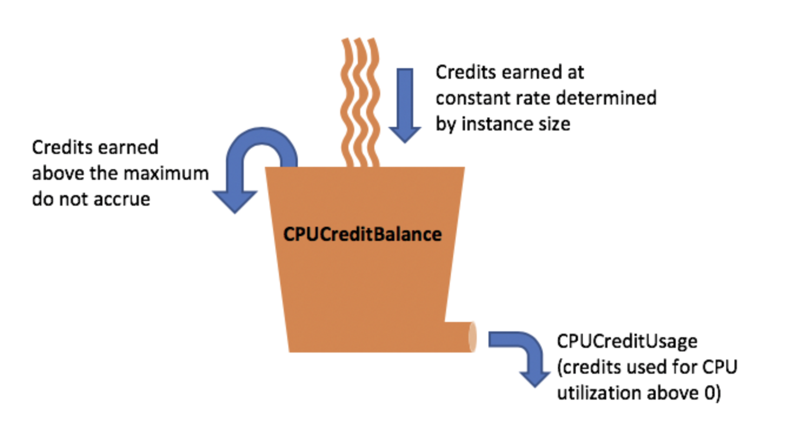
Aurora – Basics & features
Aurora Serverless:
Is an on-demand; auto-scaling configuration for MySQL & PostgreSQL edition
DB cluster → Auto start up; shut down; scale up and scale down
Cost Benefit for infrequent; intermittent or unpredictable workloads
RDS instance types:
Burstable & Memory optimized
Burstable perf instance earns credits (milliSec level resolution)
https://docs.aws.amazon.com/AWSEC2/latest/UserGuide/burstable-credits-baseline-concepts.html
Amazon Aurora
Notes:
RDS instances types: Bustable & memory
https://docs.aws.amazon.com/AWSEC2/latest/UserGuide/burstable-performance-instances-standard-mode-concepts.html#launch-credits

Slide 11
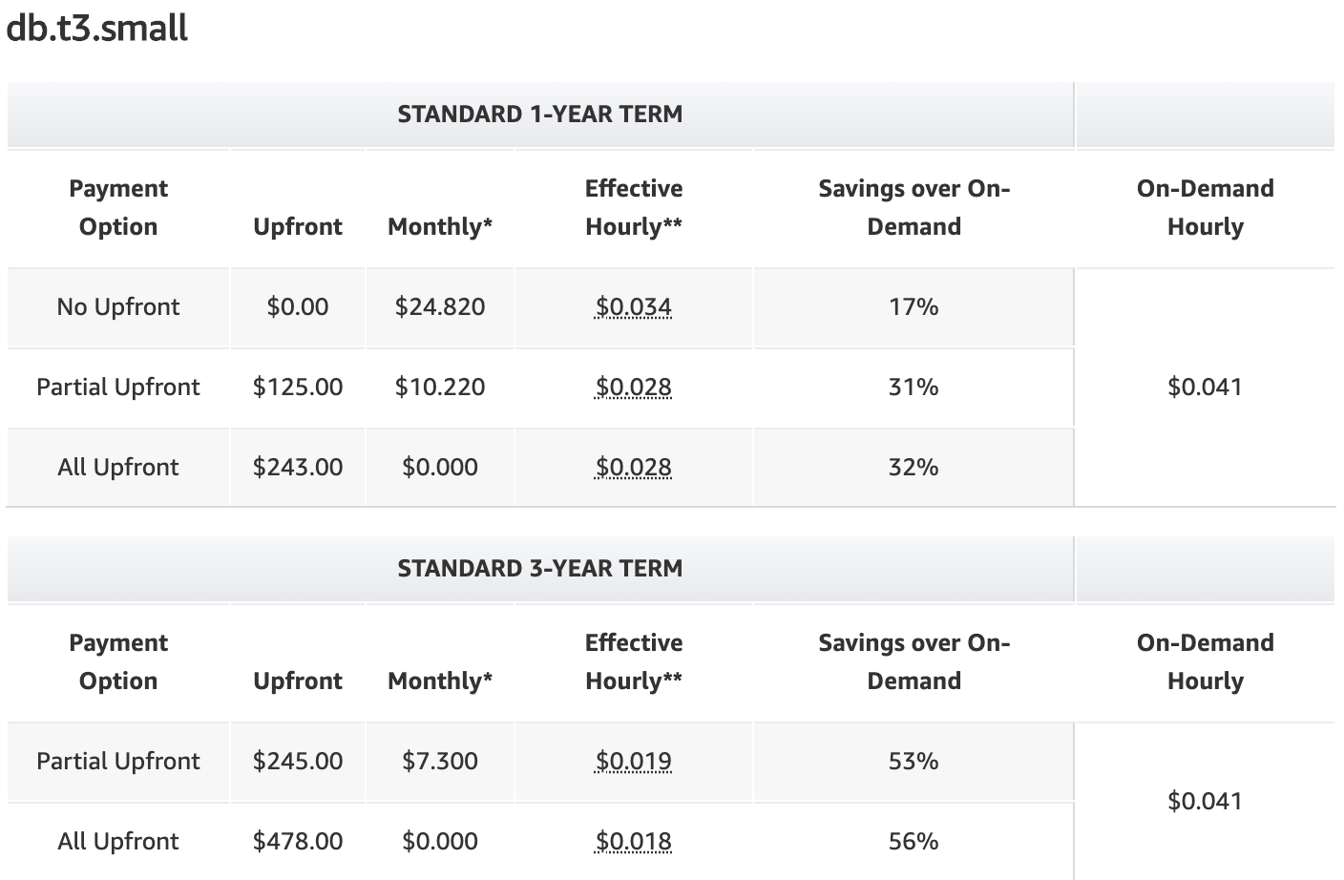
Aurora Pricing
Aurora pricing - By DB instance On-demand:MySQL compatible & PostgreSQL compatible
Per DB instance-hour (launched to stopped/deleted)
Partial – 1 sec incremental (10 min minimum)
Pricing applies to → Primary + replicas Ex: Cost of multi-AZ = Cost (primary instances + Aurora replicas)
Serverless: No instances to manage (scales up and down)
Database capacity is measured in Aurora Capacity Units (ACUs)
1 ACU = ~2GB Mem = $0.06 per ACU hour
Reserved instances:
Longer you reserve, better offers
more Upfront, better savings
Notes:
Pricing:
https://aws.amazon.com/rds/aurora/pricing/
https://aws.amazon.com/blogs/database/using-in-region-read-replicas-in-amazon-rds-for-sql-server/?nc1=b_rp
https://aws.amazon.com/rds/aurora/pricing/?pg=pr&loc=1
https://aws.amazon.com/rds/aurora/serverless/#pricing

Slide 12
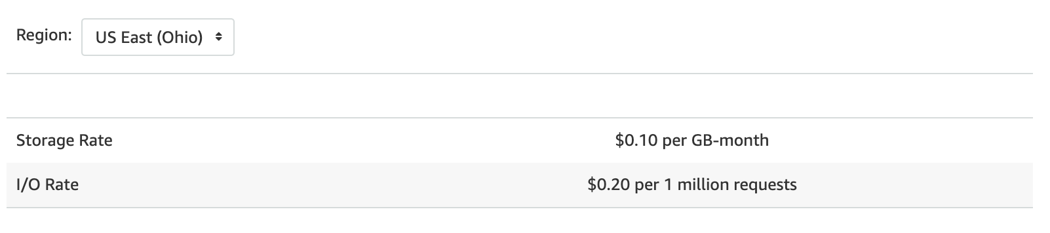
Aurora Pricing Cont..
By Storage & IOs Storage is billed in per GB-month increments
IOs consumed are billed in per million request increments.
Replication writes I/Os
Backup storage & Backtrack
Snapshot export & Data transfer
Notes:
Pricing:
https://aws.amazon.com/rds/aurora/pricing/
https://aws.amazon.com/blogs/database/using-in-region-read-replicas-in-amazon-rds-for-sql-server/?nc1=b_rp
https://aws.amazon.com/rds/aurora/pricing/?pg=pr&loc=1

Slide 13
Demo….

Slide 14
Thank you !!

